Slide 1
International Research at the University of Minnesota
Efi Foufoula-Georgiou
Presentation to the Council of Research Associate Deans (CRAD)
November 20, 2014

Slide 2
Review the VP International Research Committee Recommendations – townhall meeting, June, 2014
Present some personal perspectives on International research

Slide 3
Action Plan to Enhance and Elevate
International Research at the U of M
International Research Draft Recommendations
International Research
Town Hall Meeting June 13, 2014

Slide 4
FIVE YEARS FORWARD: INTERNATIONAL RESEARCH
The Committee Appointed by Dr. Brian Herman, VP of Research
Karen Brown, Interdisciplinary Center for the Study of Global Change
David Boulware, Department of Medicine
Steve Colman, UMD Large Lakes Observatory
John Deen, Department of Veterinary Population Medicine
Efi Foufoula-Georgiou, Department of Civil Engineering
Michael Houston, Department of Marketing
Chandy John, Department of Pediatrics
Harry Lando, School of Public Health, Epidemiology
Allen Levine, College of Food, Agriculture and Natural Resource Sciences
Meredith McQuaid, Vice-President for International Programs
James D. Neaton (chair), School of Public Health, Biostatistics
Terry Roe, Department of Applied Economics
Abdi Samatar, Department of Geography, Environment and Society
Peggy Sundermeyer, Office of the Vice President of Research

Slide 5
FIVE YEARS FORWARD: INTERNATIONAL RESEARCH
Charge to the Committee by Vice-President Herman
Review the breadth of international research at the University
Identify short- and long-term objectives and priorities for how the University can enhance it’s reputation as a leader of global research
Design a structure or model that promotes ongoing collaboration and leadership
Recommend ways in which the Vice President’s Office can more effectively nurture and support international research by our faculty
Define measureable milestones and goals

Slide 6
FIVE YEARS FORWARD: INTERNATIONAL RESEARCH
Committee Report
5 recommendations to be implemented in coming year
5 additional recommendations to be implemented over next 5 years
Metrics to evaluate progress

Slide 7
FIVE YEARS FORWARD: INTERNATIONAL RESEARCH
FIVE RECOMMENDATIONS TO BE IMMEDIATELY IMPLEMENTED
Vision -- Clearly articulate a vision and mission statement for international research by University faculty
Database -- Establish a database of international research at the University.
Strategic Alliances -- Prepare a position statement on how international partners are chosen for strategic alliances and broadly communicate which alliances have already been formed
Invest & Incubate -- Provide grants to faculty for outstanding international research projects that will enhance and elevate international research at the University
Central support -- With central support, organize the funding and human resources necessary to facilitate and nurture the growth of international research at the University.

Slide 8
FIVE YEARS FORWARD: INTERNATIONAL RESEARCH
VISION AND MISSION
Vision:
“Driving discovery and innovation at world leadership levels through international collaborations that enhance the experience and impact of faculty and students.”
Mission:
“To create strong, lasting, and mutually beneficial international research collaborations which enhance knowledge, education, innovation, and economic vitality, and contribute to the stewardship of the planet.”

Slide 9
FIVE YEARS FORWARD: INTERNATIONAL RESEARCH
Database: Definition of International Research
Research collaborations range from sharing advice/ideas/data on occasion to multi-year research projects.
A broad definition: “Movement of people, materials, or money to support international research collaborations.”

Slide 10
FIVE YEARS FORWARD: INTERNATIONAL RESEARCH
Database: Other Considerations
Comprehensive, up to date, broadly accessible
“Pyramid” design with interactive map
Coordination AND support of data collection with departments/colleges
Multiple uses, including up to date information for presentations by U of M leadership and an annual report on international research

Slide 11
FIVE YEARS FORWARD: INTERNATIONAL RESEARCH
Strategic Alliances: Background
While most international research is “bottoms up”, strategic alliances should be formed considering general U of M objectives.
A comprehensive list of strategic research alliances is not available.
Process for identifying international partners for strategic research alliances should be transparent.

Slide 12
FIVE YEARS FORWARD: INTERNATIONAL RESEARCH
Strategic Alliances: SELECTION
In addition to considering U of M objectives:
Mutually beneficial to University investigators and international partners.
Likelihood for long-term and broad-based interdisciplinary research activities.
Potential for creating teaching-research opportunities.
Other criteria?

Slide 13
FIVE YEARS FORWARD: INTERNATIONAL RESEARCH
Faculty Grants: GOALS
Formation of novel partnerships
Enhancement of existing international partnerships
Capacity building of international partners
Support of trainees and junior faculty in established research partnerships
Pilot/seed for larger external grants

Slide 14
FIVE YEARS FORWARD: INTERNATIONAL RESEARCH
Faculty Grants: Review and Funding
Prestigious grants with a high bar for funding
Reviewed by experts in subject matter area
Review Criteria:
Quality of science
Bilateral nature of research project
Involvement of students and faculty in research
Plans for research dissemination
Likelihood of future external funding

Slide 15
FIVE YEARS FORWARD: INTERNATIONAL RESEARCH
Central Support for Organization of Funding and Human Resources
Significant investment is required:
Liaise with other universities and assess the magnitude of the investment required to make the University a premier leader in global research.
Promote the University’s international research and communicate how discoveries, novel ideas, and new approaches to address global problems benefit citizens of Minnesota.
A sustainable funding model (9th recommendation).

Slide 16
FIVE YEARS FORWARD: INTERNATIONAL RESEARCH
Central Support (cont.)
Provide guidance to faculty on the management and risks of conducting research in different locations.
Address University obstacles to international research.
Work with colleges/departments to determine which responsibilities should be decentralized.

Slide 17
FIVE YEARS FORWARD: INTERNATIONAL RESEARCH
FIVE RECOMMENDATIONS TO BE IMPLEMENTED OVER THE NEXT 5 YEARS
Unique strengths: After the database is built, use it to determine what makes the University unique or strong in international research and invest more strongly in those areas.
New alliances: Develop new strategic alliances, possibly with regional hubs, considering the position statement (3rd recommendation).
Increase investment: Increase University investment in international research infrastructure and administration.
Sustainable funding: Develop a sustainable funding model for international research that includes external funding, internal funding and philanthropic gifts.
Recruitment: Recruit junior, mid-level and senior faculty with international research interests.

Slide 18
FIVE YEARS FORWARD: INTERNATIONAL RESEARCH
Metrics to Evaluate Performance
Bibliometric statistics on faculty publications with international partners
Patents with international partners
Research awards by U.S. funders for international research
Research awards by international funders for international research
Student support and/or field trips associated with international research projects
Awardees of international seed and other grants by the University
New strategic alliances formed

Slide 19
Personal reflection

Slide 20
1. Research and Discovery, 2. Teaching and Learning, 3. Outreach and Public Service

Slide 21
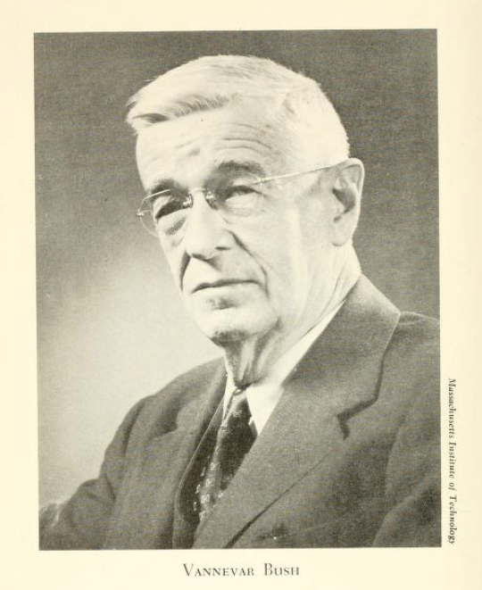
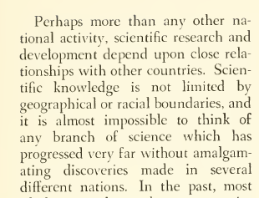
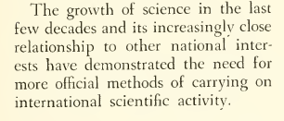
ESTABLISHMENT OF THE NATIONAL SCIENCE FOUNDATION
Vannevar Bush, 1944 – argued that basic research would have to be strengthened by the use of public funds
Congress passed the NSF Act of 1950 establishing NSF
https://ia700408.us.archive.org/18/items/scienceendlessfr00unit/scienceendlessfr00unit.pdf

Slide 22
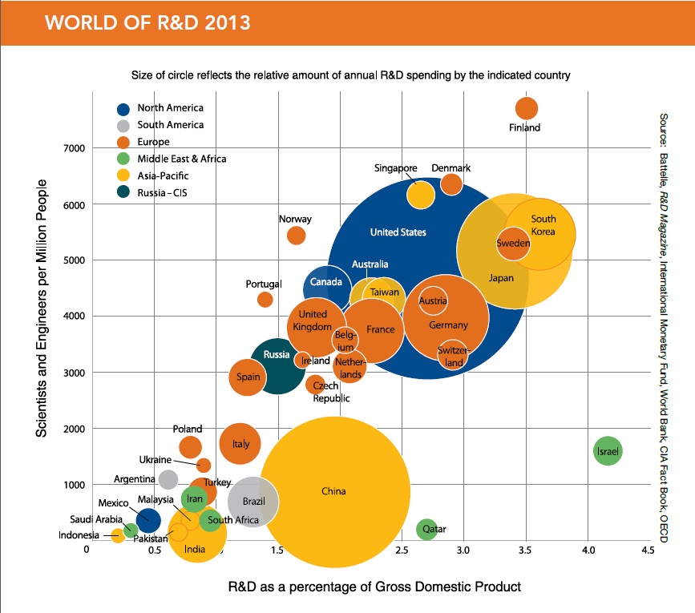

Slide 23
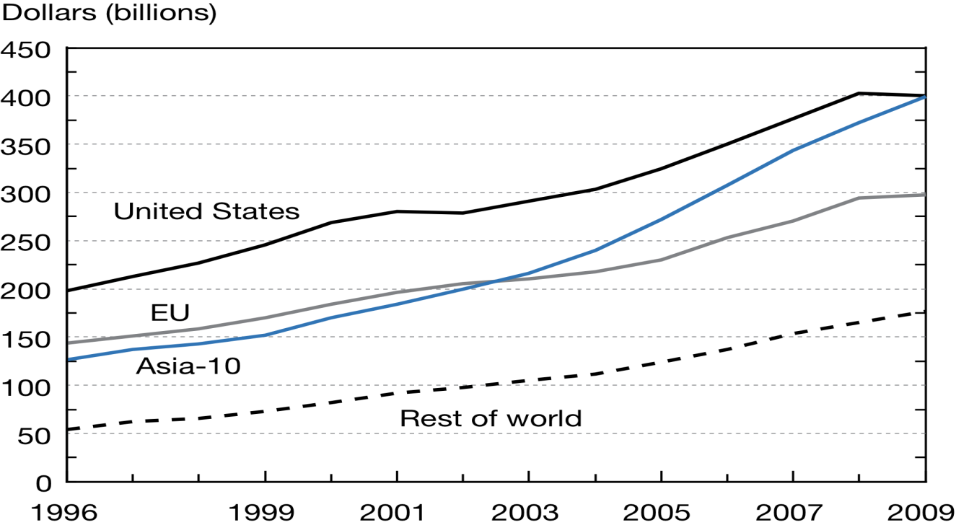
R&D expenditures for United States, EU, and 10 Asian economies: 1996–2009
Asia-10 = China, India, Indonesia, Japan, Malaysia, Philippines, Singapore, South Korea, Taiwan, Thailand; EU = European Union
Source: National Science Board, Science and Engineering Indicators 2012

Slide 24
Country Goals
China – seeks to increase R&D to 2.5% of GDP by 2020
Brazil: 2.5% by 2022
South Korea: 5% by 2022
EU: Lisbon goal of 3%
USA: goal of 3%
Japan: well above 3%

Slide 25
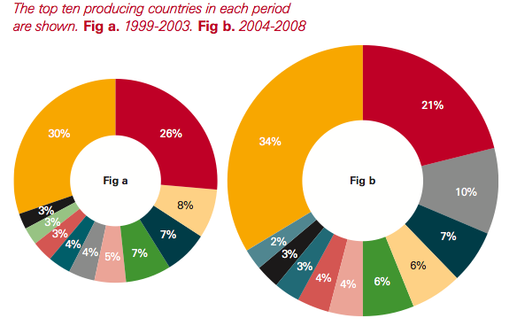
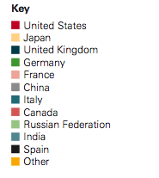
Proportion of Global Publications, by Country
Source: Elsevier Scopus, Royal Society

Slide 26
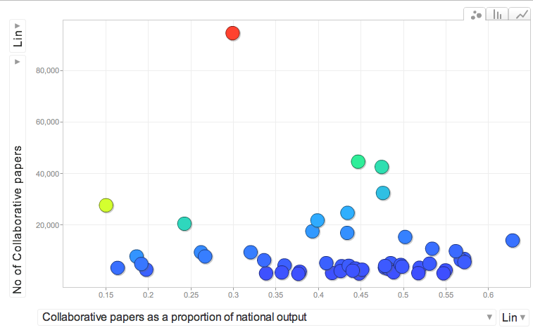
Internationally Collaborative Papers (2008)
Source: Royal Society
United States (2008)
80,000
60,000
40,000
20,000
0
Number of Collaborative Papers
United States (1996)
UK
Germany
France
China
Japan
Switzerland
China
1996
0.15 0.2 0.25 0.3 0.35 0.4 0.45 0.5 0.55 0.6
Collaborative Papers as a proportion of national output

Slide 27
Approximately 35% of the world’s papers now have more than one international author
Guinness Book of Records: the largest number of international collaborators on a single paper: 3,222 from 32 different countries (yes, from CERN)

Slide 30
The Belmont Forum gathers the world’s major and emerging funders of global environmental change research, and international science councils
Acting as Council of Principals for IGFA, a larger group of funding agencies
Australia/CSIRO
Brazil/FAPESP
Canada/NSERC
China/NSFC
European Commission/DG R&I
France/CNRS&ANR, co-chair
Germany/DFG&BMBF
India/MoES
Italy/CNR
Japan/MEXT&JST
South Africa/NRF, co-chair
Sweden/SSEESS
United Kingdom/NERC
United States/NSF
International Council for Science (ICSU)
International Social Sciences Council (ISSC)

Slide 31
Funders
Academics
S & T Alliance for
Global Sustainability
UN bodies
WMO
as observer
>>> A critical mass with strong international visibility
http://igfagcr.org

Slide 33
L
The “BF-DELTAS Team”
Led by University of Minnesota
USA: E. Foufoula-Georgiou and V. Voller (Univ. of MN); I. Overeem (Univ. of Colorado); S. Goodbred (Vanderbilt University); I. Harrison (Int. Union for Conservation of Nature); C. Vorosmarty and Z. Tessler (City College of New York); E. Brondizio (Indiana University)
Japan: Y. Saito (Geological Survey of Japan, Japan);
Germany: S. Dech and C. Kuenzer (University of Wuerzburg); F. Renaud (United Nations Univ.);
France: E. Anthony (Aix-Marseille University);
U.K: Z. Matthews, R. Nicholls, J. Dearing, A. Lazar, and A. Baschieri (Univ. of Southampton); J. Hutton (UNEP - World Conservation Monitoring Centre);
India: R. Ramachandran (Anna Univ.)
Netherlands: M. Marchand and T. Bucx (Deltares)
Bangladesh: K.M. Ahmed (Univ. of Dhaka); M.M. Rahman (Bangladesh Univ. of Engineering and Technology);
Vietnam: V. L. Ngugen (Vietnam Academy of Science and Technology); M. Goichot (World Wide Fund for Nature – Greater Mekong)
Norway: A. Newton (Norwegian Inst. for Air Research, Norway);
Brazil: S. Costa (University of Vale do Paraíba),
Canada: G. Lintern (Natural Resources Canada); P. Van Cappellen and H. Durr (University of Waterloo),
China: S. Gao (Nanjing Univ.)

Slide 35
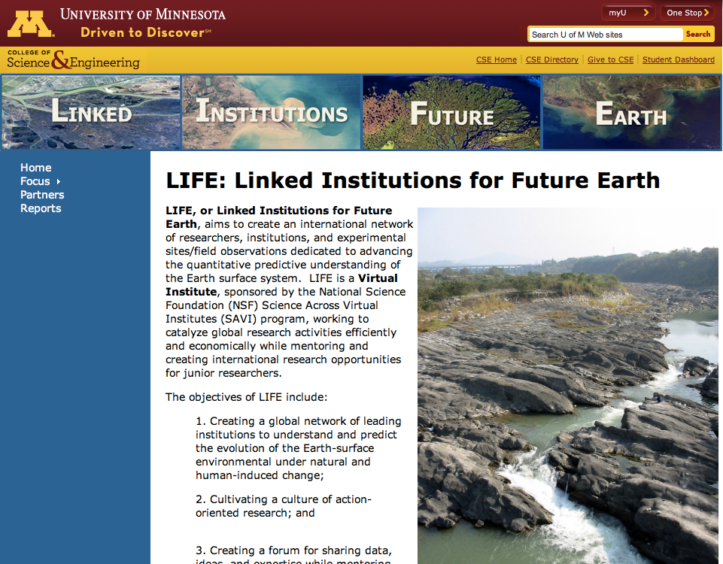

Slide 39
Strategic Partnering
Lead on a handful of Strategic grand challenges (e.g., sustainability, big data, collaboration technologies, research-infused education, etc.)
Scientific infrastructure and facilities
Adopt best practices – emphasis on leveraging
Partnerships with emerging powerhouses
Strategic regional hubs (including developing world)
Develop the human capital

Slide 40
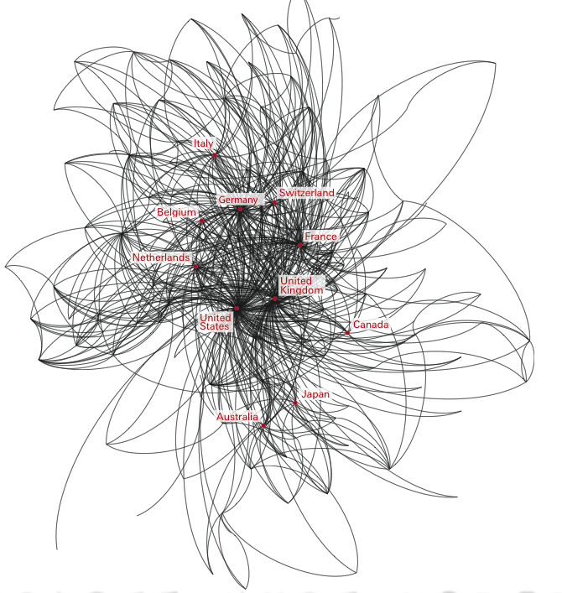
Closing thoughts
“The days of overwhelming U.S. science dominance are over, but the country can actually benefit by learning to tap and build on the expanding wellspring of knowledge being generated in many countries.”
The Shifting Landscape of Science, C. S. Wagner, Issues Online in Science and Technology, NRC, 2011
Who is collaborating with who?

