Slide 1

INTELLIGENCE 2025
to improve life on Earth
TAU-UCI
Nov 13, 2018
Efi Foufoula-Georgiou
University of California Irvine (UCI)

Slide 2
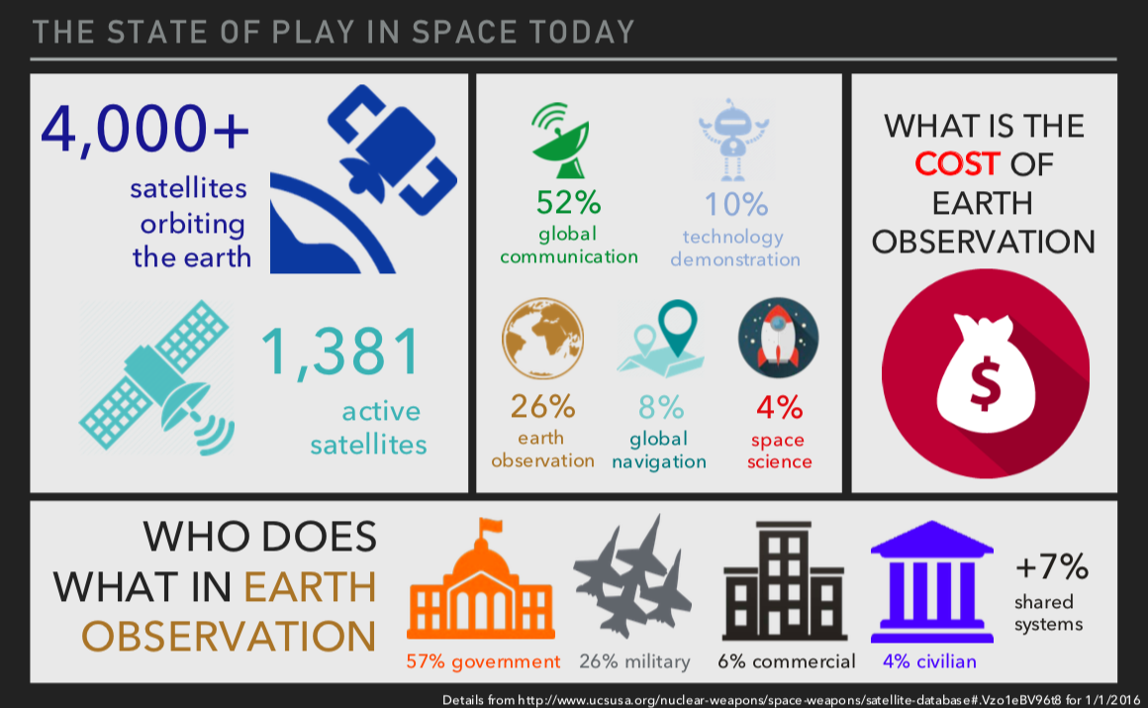
THE STATE OF PLAY IN SPACE TODAY

Slide 3
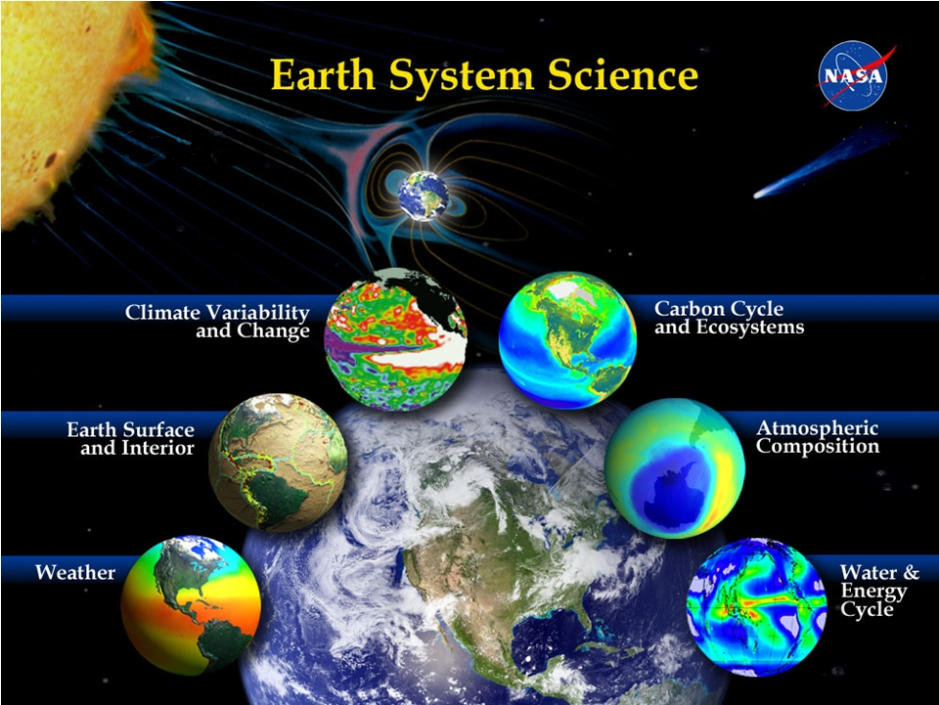
Understanding Earth from Space
Courtesy of Michael Freilich, NASA

Slide 4


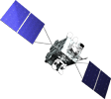


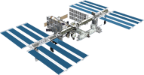

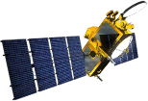

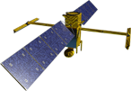
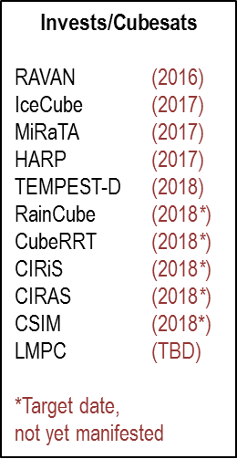



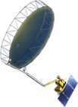




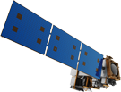


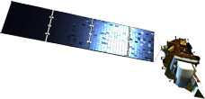

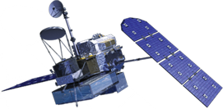

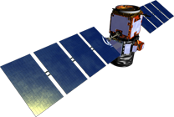

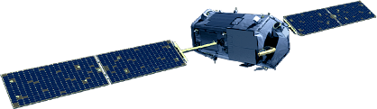
Earth Science Missions
FY17 Program of Record
Landsat 9 (2020)
PACE (2022)
GeoCARB (~2021)
ISS Instruments
CATS (2020), LIS (2020), SAGE III (2020)
TSIS-1 (2018), OCO-3 (2018), ECOSTRESS (2017), GEDI (2018)
CLARREO-PF (2020)
TROPICS (12) (~2021)
MAIA (~2021)
Sentinel-6A/B (2020, 2025)
NI-SAR (2021)
JPSS-2 Instruments
RBI (2018), OMPS-Limb (2018)
SWOT (2021)
TEMPO (2018)
GRACE-FO (2) (2018)
Formulation
ICESat-2 (2018)
NISTAR, EPIC
(DSCOVR / NOAA)
(2019)
Implementation
CYGNSS (8) (2019)
Primary Ops
Extended Ops
SMAP (>2022)
Landsat 7
(USGS) (~2022)
QuikSCAT (2017)
SORCE,
TCTE (NOAA) (2017)
Suomi NPP (NOAA) (>2022)
Terra (>2021)
Landsat 8
(USGS) (>2022)
Aqua (>2022)
CloudSat (~2018)
CALIPSO (>2022)
GPM (>2022)
Aura (>2022)
GRACE (2) (2018)
OSTM/Jason-2
(NOAA) (>2022)
OCO-2 (>2022)
Courtesy of Michael Freilich, NASA
06.26.17

Slide 5
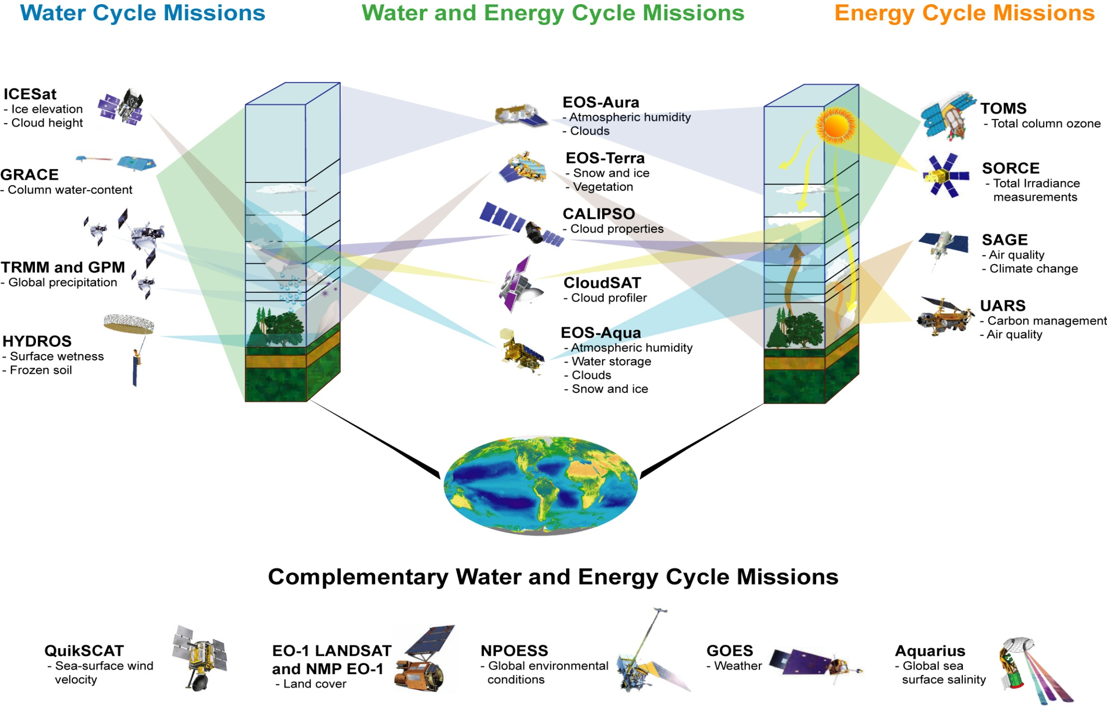
NASA’s Water and Energy Cycle Missions
(SMAP)
Planned (not Approved)
SWOT (Streamflow)
SCLP (Snowpack)
Courtesy of Michael Freilich, NASA

Slide 6
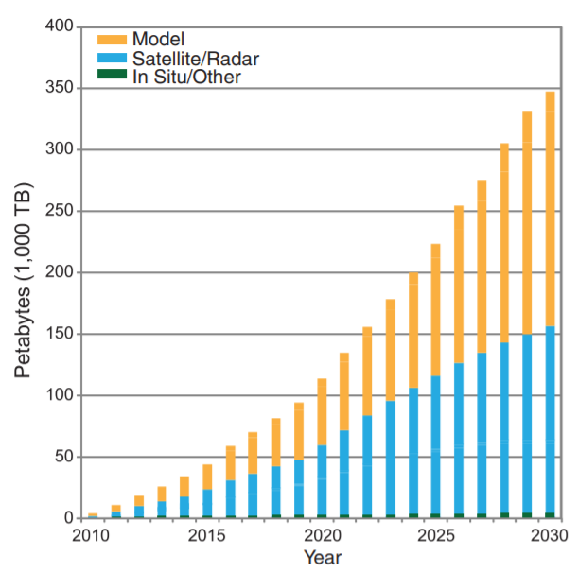
Exploding Volume of Climate Data from Space
Overpeck et al,
Science, 2011

Slide 7



3 Themes @ UCI
Precipitation estimation from space
Climate dynamics for prediction
Landforms supporting life (rivers, deltas)

Slide 8
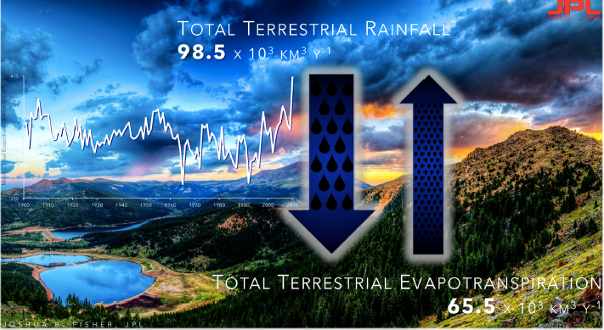
1. PRECIPITATION
Water cycle dynamics at global to regional scales
Monitoring extremes (hurricanes, tropical storms)
Improving weather and climate models

Slide 9
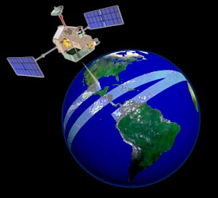
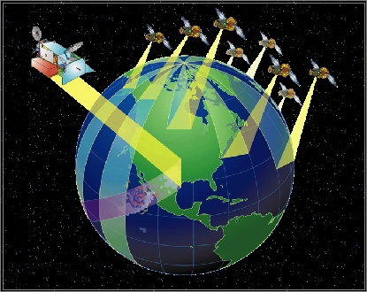
From TRMM to GPM
TRMM
GPM
Covering 35S to 35N
Microwave Imager (TMI)
-- 9 channels
-- frequencies 10.7-to-85.5 GHz
-- swath width 878 km
Precipitation radar (PR)
-- single-frequency Ku band (13 GHz)
-- swath width 247 km
Covering 68S to 68N
GPM Microwave Imager (GMI)
-- 13 dual-polarized channels
-- frequencies 10.65-183.3 GHz
-- swath width 885 km
Dual Polarization radar (DPR)
-- dual-frequency Ku & Ka (13 and 35 GHz)
-- swath width 120, 245 km

Slide 10
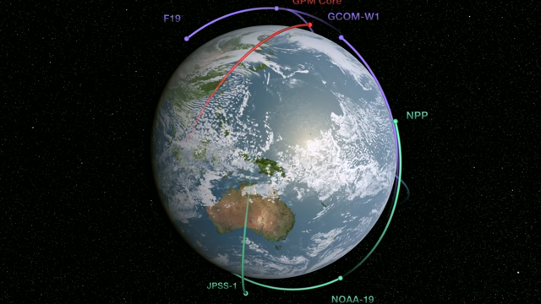
From TRMM to GPM
TRMM
GPM
Covering 35S to 35N
Microwave Imager (TMI)
-- 9 channels
-- frequencies 10.7-to-85.5 GHz
-- swath width 878 km
Precipitation radar (PR)
-- single-frequency Ku band (13 GHz)
-- swath width 247 km
Covering 68S to 68N
GPM Microwave Imager (GMI)
-- 13 dual-polarized channels
-- frequencies 10.65-183.3 GHz
-- swath width 885 km
Dual Polarization radar (DPR)
-- dual-frequency Ku & Ka (13 and 35 GHz)
-- swath width 120, 245 km

Slide 11
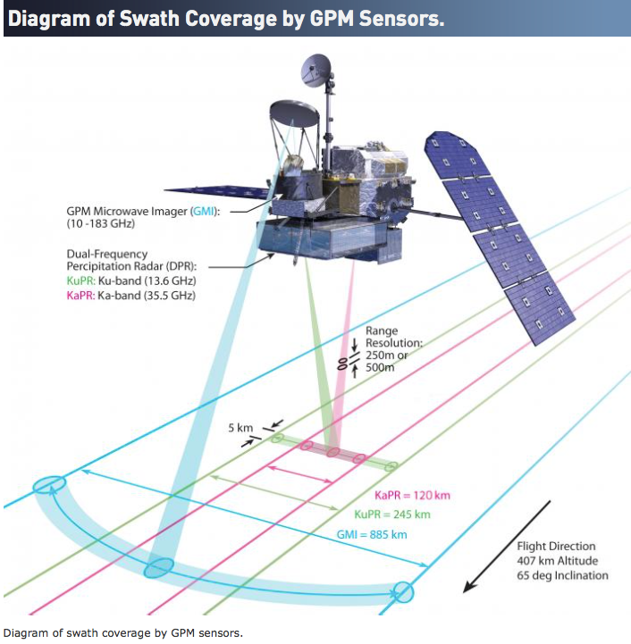
GPM Core Satellite

Slide 12
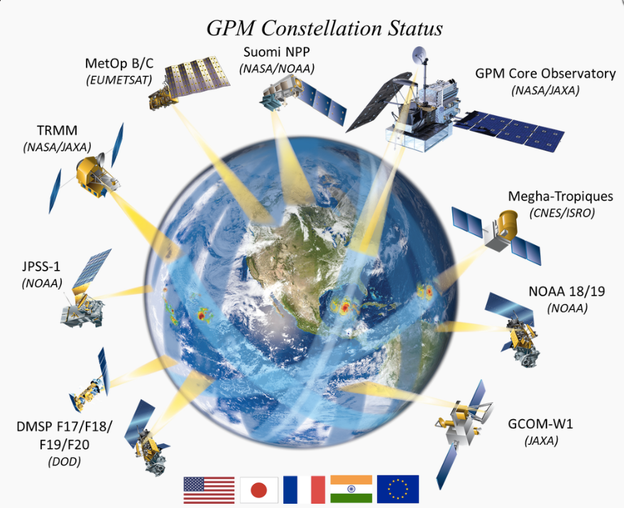
GPM Constellation

Slide 13
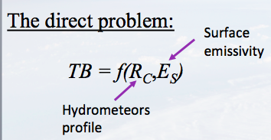
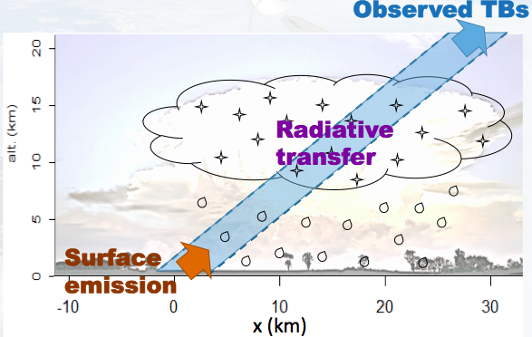
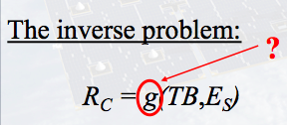
Passive Microwave Retrieval:
An underdetermined Inverse problem
Accurately resolved by numerical
(physical) radiative transfer models
Underdetermined

Slide 14
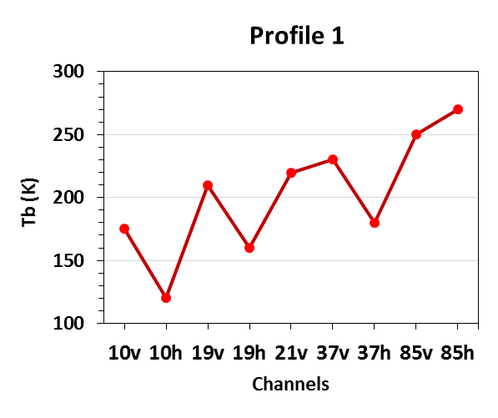
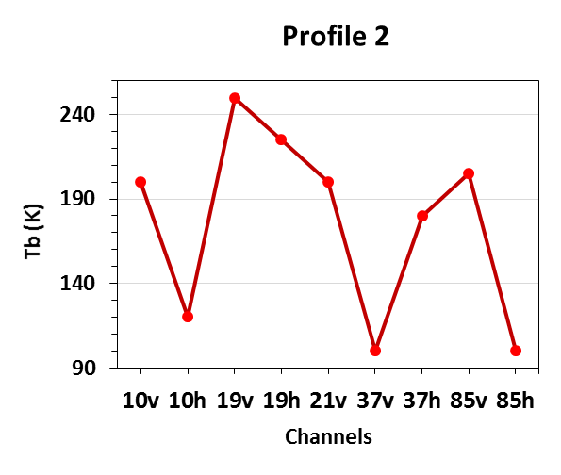
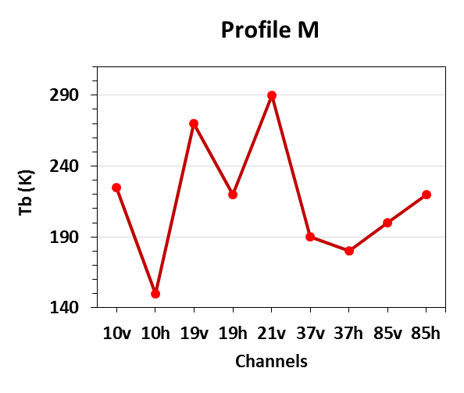
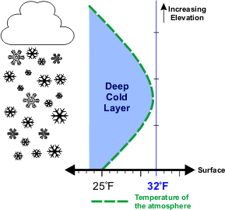
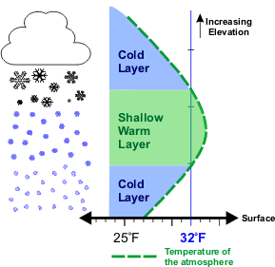
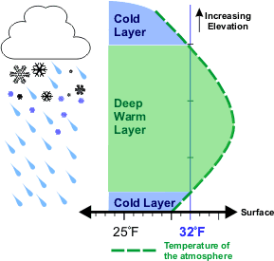
Passive Microwave Retrieval: an Inverse Problem
Learn patterns from data for retrieval
  Spectral BT
  Rainfall Profiles
Machine Learning and Regularized Estimation in High Dimensional Spaces
13-dim space
(each point is a
BT vector)
Manifold of BT
n-dim space
(each point is a Z,
surf R vector)
Manifold of R
“Manifold learning”
Database
  Spectral BT
x₁
x₂
x_{M}
  Rainfall Profiles

Slide 15






ShARP: Locally linear embedding for rainfall retrieval
Inversion Algorithm based on Regularization:
  Concept of the locally linear embedding (supervised manifold learning):
radiometer
radar
raining
non-raining
  Search for the K-nearest neighbors to detect raining signatures
  Estimate the representation coefficients and thus the rainfall profile
Foufoula-Georgiou et al., Survey in Geophysics, 2015; Ebtehaj, Foufoula-Georgiou, Lerman, Bras, GRL, 2015
Ebtehaj, Bras, Foufoula-Georgiou, IEES, 2015; & J. Hydrometeorology, 2016; Takbiri, Ebtehaj, Foufoula-Georgiou, HESS, 2017
Saul and Roweis, Science, 2000

Slide 16
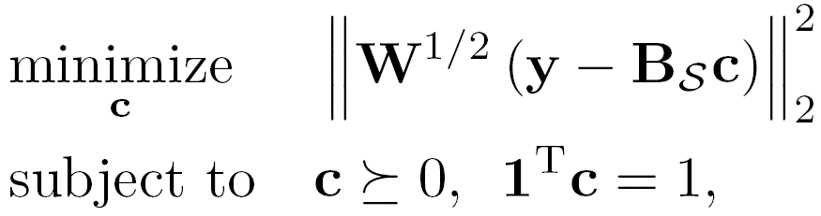
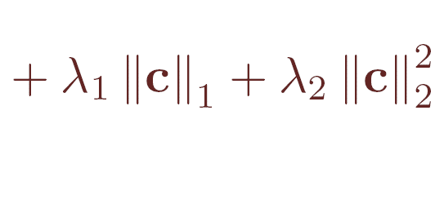



ShARP: Locally linear embedding for rainfall retrieval
  Detection step:
    K-nearest neighborhood search + a probabilistic voting rule for rain/no-rain
  Estimation Step:
    Estimation of the representation coefficients
L1-L2 regularization for stability and reduced estimation error
    Rainfall estimates

Slide 17
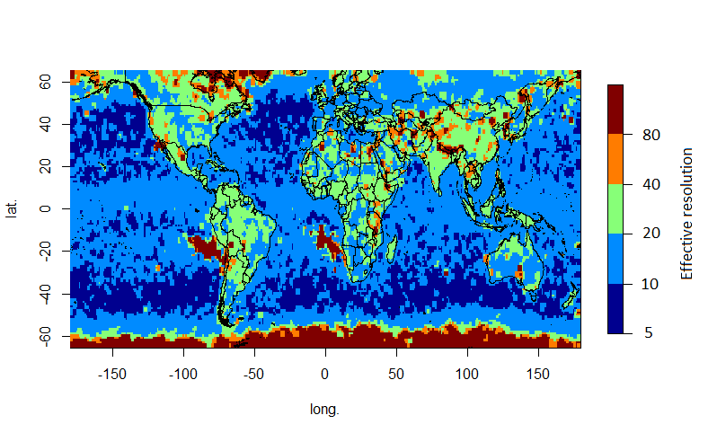
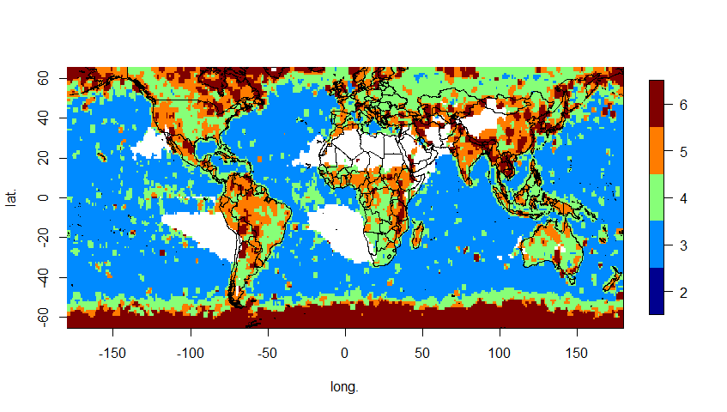
Yet, lacking performance in several places of the world
Effective Resolution (ER) of NASA’s GPROF v7 (GMI vs KuPR)
(km)
latitude
longitude
Local values computed from all observations in 3°×3° boxes.
March 2014 to February 2017: 16,500 GPM orbits
Guilloteau, Foufoula-Georgiou, Kummerow, J. Hydrometeorology, 2017.

Slide 18
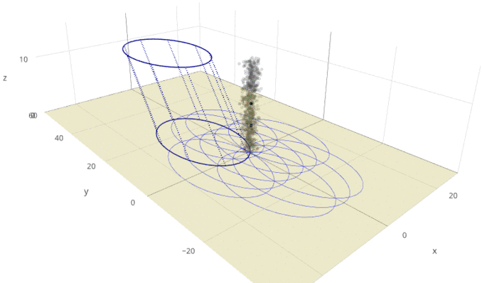
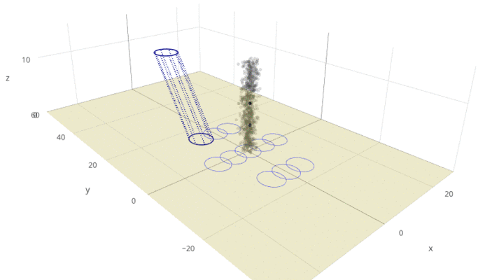
New Direction: Retrieve patterns (not a pixel at a time)
7
Learn from the spatial structure in the TB space
1) Sensor Geometry: with different channels responding to different altitude levels, the multi-spectral signature characterizing a given vertical column may be split across several pixels.
2) Specific spatial patterns of TBs are the signatures of specific atmospheric features
11 GHz
89 GHz
QU: HOW TO IDENTIFY THE NEIGHBOROOD AND HOW TO LEARN FROM IT?
It becomes a very high dimensional problem! Need to learn features!

Slide 19
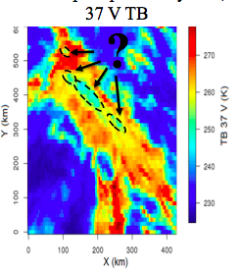
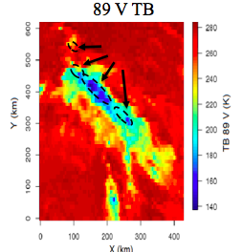
New Direction: Retrieve patterns not a pixel at a time
7
Learn from the spatial structure in the TB space
1) Sensor Geometry: with different channels responding to different altitude levels, the multi-spectral signature characterizing a given vertical column may be split across several pixels.
2) Specific spatial patterns of TBs are the signatures of specific atmospheric features
11 GHz
89 GHz
Lower 37V =>
Lower emission signal =>
Lower precipitation?
NO! It is an ice
Scattering signal=>
Very active convective
Cell

Slide 20
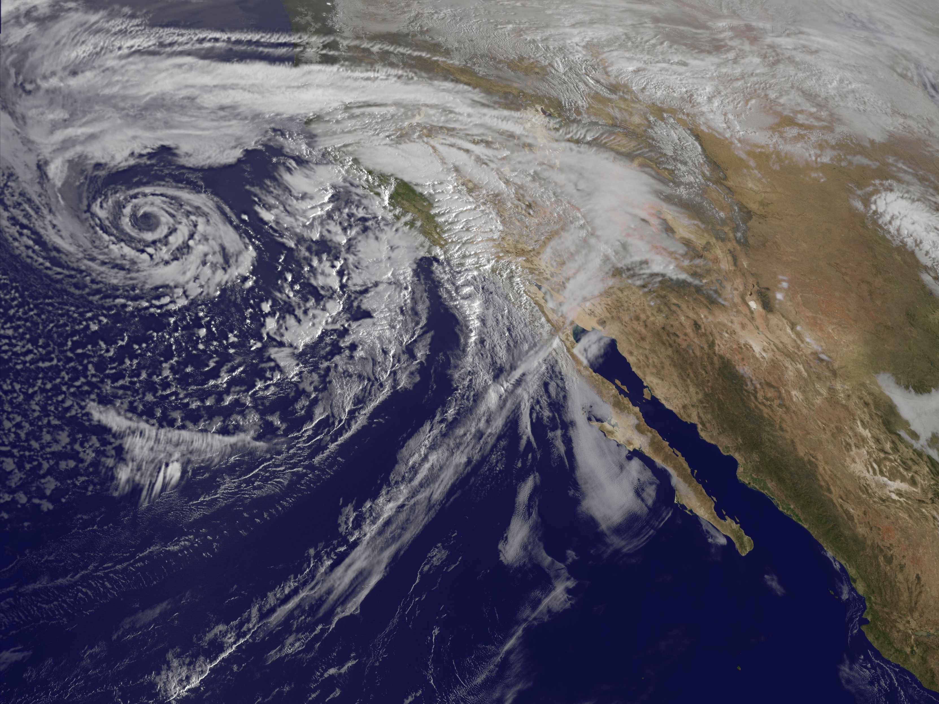
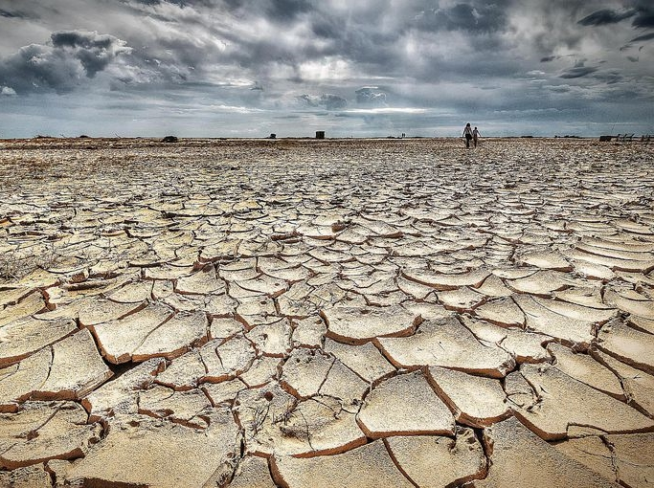
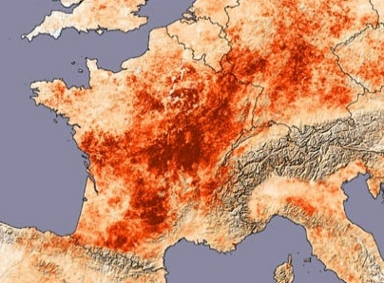
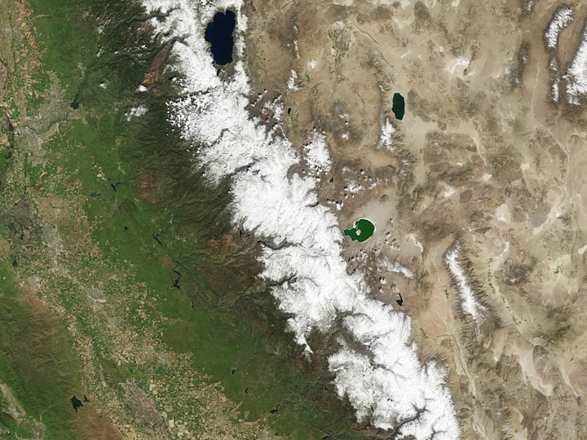
2. SEASONAL PREDICTION
How to best combine climate observations
and models to improve predictions?

Slide 21
Bridging the gap: weather and climate
NAS (2016) Next Generation Earth System Prediction: Strategies for Subseasonal to Seasonal Forecasts
36-hr and 72-hr ahead
weather forecasts are
getting better and better…
36 hrs
72 hrs

Slide 22
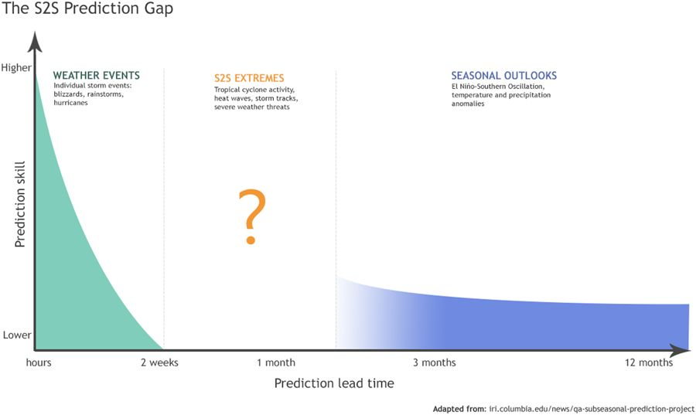
Bridging the gap: weather and climate
NAS (2016) Next Generation Earth System Prediction: Strategies for Subseasonal to Seasonal Forecasts
36-hr and 72-hr ahead
weather forecasts are
getting better and better…
Mariotti et al (2018) Climate and Atmospheric Science, doi:10.1038/s41612-018-0014-z
Mariotti et al (2018) Climate and Atmospheric Science, doi:10.1038/s41612-018-0014-z
Our prediction skill on
subseasonal (week timescales)
to seasonal (S2S) timescales is
still very limited
2 weeks
2 months

Slide 23
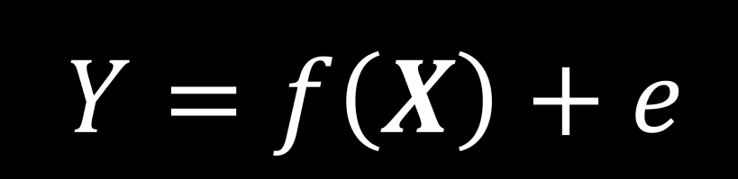
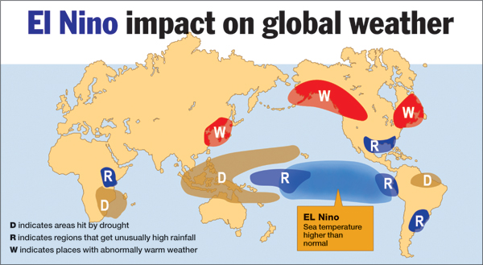
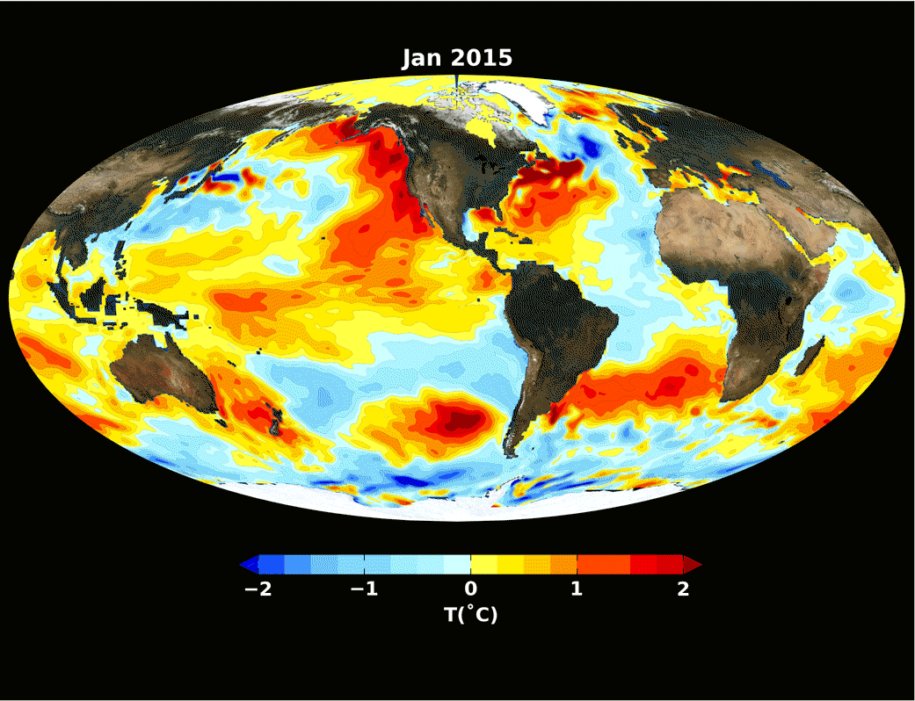

Combining physics and statistics
Climate models show limited skill in predicting seasonal precipitation months ahead
Best approach to predict is combining our physical understanding with statistical tools:
Large-scale climate modes (e.g. ENSO see below)
Regional hydroclimate (e.g. precipitation, temperature in California)
$$Y=f\left(X\right)+e$$
The Great El Niño in 2016
anomaly

Slide 24
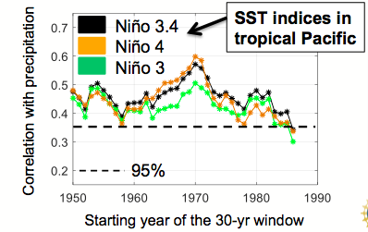
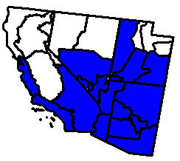
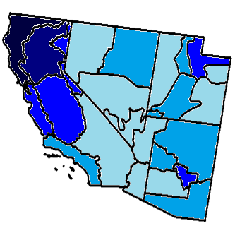
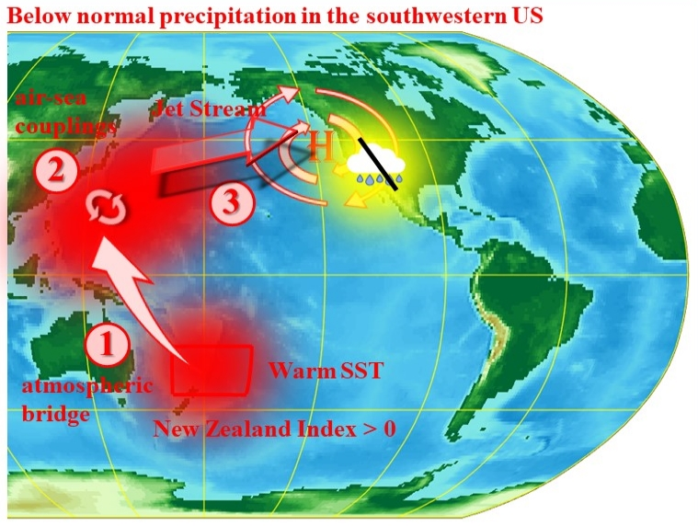
Learning from Big Data
What are the best sources of predictability
for a specific region? Are they changing?
ML and Network analysis can extract
much relevant information from the data
to improve prediction
Example: Precipitation in southwestern US
Dry and variable hydroclimate
New climate mode discovered, different than ENSO
annual precipitation (mm/yr)
Nevada
Utah
California
100-300
300-500
Arizona
500-700
~ 900
~ 1250
(Mamalakis et al., 2018, Nature Communications)

Slide 25






Learning from Big Data
(Mamalakis et al., 2018, Nature Communications)
This new mechanism has been more dominant in modulating SWUS precipitation in the last 3 to 4 decades:
  Vector X may not include important/new modes if based only on our prior knowledge
  Function f is not constant through time
In our new project (funded by ), we use machine learning to address this problem:
$$E\left[y_{t}\right]=\left\langle x_{t},\left.β\right\rangle \right.$$
  linear model
Where the relative contribution of each feature in X is represented by β and is calculated by minimizing:
  Spatial dependence
$$\hat{β}=arg\min_{β}{\sum_{t=1}^{N}{{(y_{t}−\left\langle x_{t},\left.β\right\rangle \right.)}^{2}}+λ_{TV}\sum_{j,k=1}^{p}{Σ_{j,k}^{1/2}|β_{j}−β_{k}|}+λ_{1}{||β||}_{1}}$$
  Sparsity
  Fit observations
TRIPODS+CLIMATE program (NSF grant DMS-1839336)

Slide 26

Learning from Big Data
$$E\left[y_{t}\right]=\left\langle x_{t},\left.β\right\rangle \right.$$
  linear model
  Spatial dependence
  Sparsity
  Fit observations
Preliminary results are promising. We can explain more that 40% of precipitation variability in the out-of-sample period.
The patterns of β can be used to verify and reveal new mechanisms in the large-scale climate system
Such approaches can also be used for climate model diagnostics. Do climate models capture the observed interrelations and how are these projected to change under climate change?
TRIPODS+CLIMATE program (NSF grant DMS-1839336)

Slide 27









3. LANDSCAPES
What can they tell us about process
and how are they changing?

Slide 28




Remotely-sensed global imagery is paving the way for a Global Geomorphology
The two most critical problems:
Automatic extraction of dynamic objects
Automatic extraction of critical information
Robust extraction of rivers from multispectral imagery is a very nuanced problem that must consider: water level at time of image, exposed point bars, mixed pixels at boundaries, and clouds, shadows, snow cover, etc.
Following object identification (mask generation), robust algorithms must be capable of objectively distilling relevant metrics and insights without excessive manual intervention.

Slide 29

Ucayali River, Peru

Slide 30

Two critical problems
Automatic extraction of dynamic objects
Automatic extraction of critical information
Landsat
1984-2015
Robust extraction of rivers from multispectral must consider: water level at time of image, exposed point bars, mixed pixels at boundaries, and clouds, shadows, snow cover, etc.
Following object identification (mask generation), robust algorithms must be capable of objectively distilling relevant metrics and insights without excessive manual intervention.

Slide 31





Tools for large-scale mask analysis (single rivers)
Ucayali River 1,300 km long
Can predict cutoffs!!
J Schwenk, A Khandelwal, M Fratkin, V Kumar, E Foufoula‐Georgiou. (2017) Earth and Space Science
J Schwenk, E Foufoula-Georgiou. (2017) Geophysical Research Letters

Slide 32



Tools for large-scale mask analysis (river networks)
RivGraph:
a Python toolbox for analysis of deltaic and braided river channel networks
Yenisei Delta,
Russia
  flow
  directionality
upstream
Coming soon to a Conda Repository near you…
downstream
J Schwenk, A Tejedor, A Piliourais, J Rowland, E Foufoula-Georgiou. (2018) In preparation.
  extracting channel
  network topology
morphological properties and topologic metrics

Slide 33


Arctic Deltas (ADs)
The Arctic: North of 66° 33’N
  Climate change affects poles with greater intensity i.e. Polar Amplification (Serreze et al. 2009)
  ADs have on the order of 91 39 Pg-Carbon (Schuur et al., 2015)
  Lakes and ponds are significant sources of methane (i.e. further warming) (Wik, 2016)
  ADs are uniquely characterized by strong spring flooding, permafrost presence, and lake abundance (Walker, 1999)
Mackenzie Delta, Source: Sam B Cornish

Slide 34



Changes in arctic deltas under climate change
Can we infer subsurface hydrologic connectivity from the observed (surface) topology and connectivity of lakes and channels in ADs?
RivGraph for CN extraction
Approach:
We interrogate lake shrinkage rates and show that distance from the delta channel network controls lake shrinkage and thus subsurface connectivity.
P(Water_{June} → Land_{July})
100%
80%
60%
40%
20%
0%
Nearest Edge Distance [m]

Slide 35


What are we really studying?
INTELLIGENCE 2025
to improve life on Earth

Slide 36

efi@uci.edu

